Slide 1


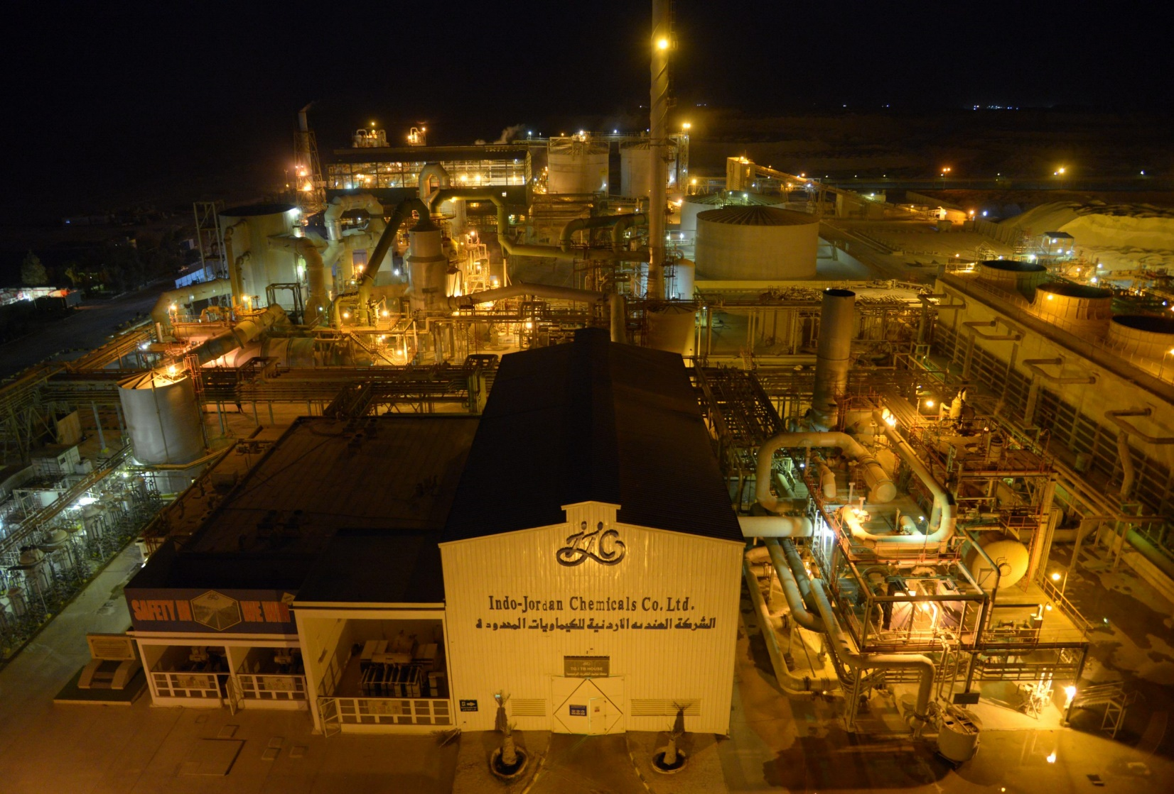
IJC -PHOSPHORIC ACID PRODUCTION CAPACITY ENHANCEMENT AND ITS IMPACT ON JORDAN’S ECONOMY
Eng A.Vettrivelmurugan, Plant Head, IJC
7th July 2025

Slide 2

INDO JORDAN CHEMICALS COMPANY LTD
Indo-Jordan Chemicals Company Limited (IJC), (wholly subsidiary of Jordan Phosphate Mines Company PLC, Jordan (JPMC), is pioneer in production of Merchant Grade Phosphoric Acid and intermediary product Sulphuric Acid at the state of art high-tech production facility at Eshidya, Hashemite Kingdom of Jordan.
The complex includes a 2,000 MTPD sulfuric acid plant using the Double Conversion and Double Absorption process by Monsanto.
Additionally, there's a 1000 MTPD P2O5 phosphoric acid plant based on the single-stage Hemi hydrate process developed by Yara.
This presentation will outline their collective efforts and highlight the significant benefits achieved through energy conservation

Slide 3

WHY DOWNSTREAM? (VALUE ADDITION)
WHY DOWN-STREAM? (VALUE ADDITION)
Raw Phosphate Rock Value: ~$70–100/tonne. Processed fertilizer value: >$400/tonne (e.g. DAP).
Value-added products (Fertilizers, Acids, etc.) bring more export earnings & profit.
Downstream processing keeps economic benefits in Jordan (jobs, taxes, FX earnings) instead of exporting raw material

Slide 4

RECENT INITIATIVES & SOLUTIONS
Increased PA Production from 700 MTPD to 900MTPD
Installation of New 700MTPD plant
Revamping of Existing 900MTPD PA Plant to achieve 1300MTPD
Target to achieve 2000 MTPD of Phosphoric Acid.

Slide 5
JORDAN: WORLD’S 3rd LARGEST PHOSPHORIC ACID EXPORTER
Ranks Second globally, with ~636,862 tons of phosphoric acid (P₂O₅) in 2023.
Ranks Third globally, with export of ~655,745 tons of phosphoric acid (P₂O₅) in 2024.
Post IJC expansion, Jordan’s position further strengthens in global supply chains.

Slide 6
IJC Design/Present & Post Revamp Production Capacity Overview
IJC SA / PA Revamp Project
# | IJC Product | Design Production Capacity |  | Present Production capacity
 |  | MT / day | MT / year | MT / day | MT / Year
1 | Sulfuric Acid | 2000 | 660000 | 2150 | 700000
2 | Phosphoric Acid (MT P205) | 700 | 224000 | 900 | 300000
Sno | IJC Product | Present Capacity
 |  | Daily Production Qty in MT/day | Yearly Production Qty in MT/Year
1 | Sulphuric Acid | 2300 | 780000
2 | Phosphoric Acid (MT P2O5) | 700 | 224000
# | IJC Product | Post Revamp Capacity
 |  | MT / day | MT / year
1 | Sulfuric Acid | 4450 | 1.5 Million MT SA
2 | Phosphoric Acid (MT P2O5) | 1500 | 0.5Million MT P2O5
All Quantity in MT

Slide 7
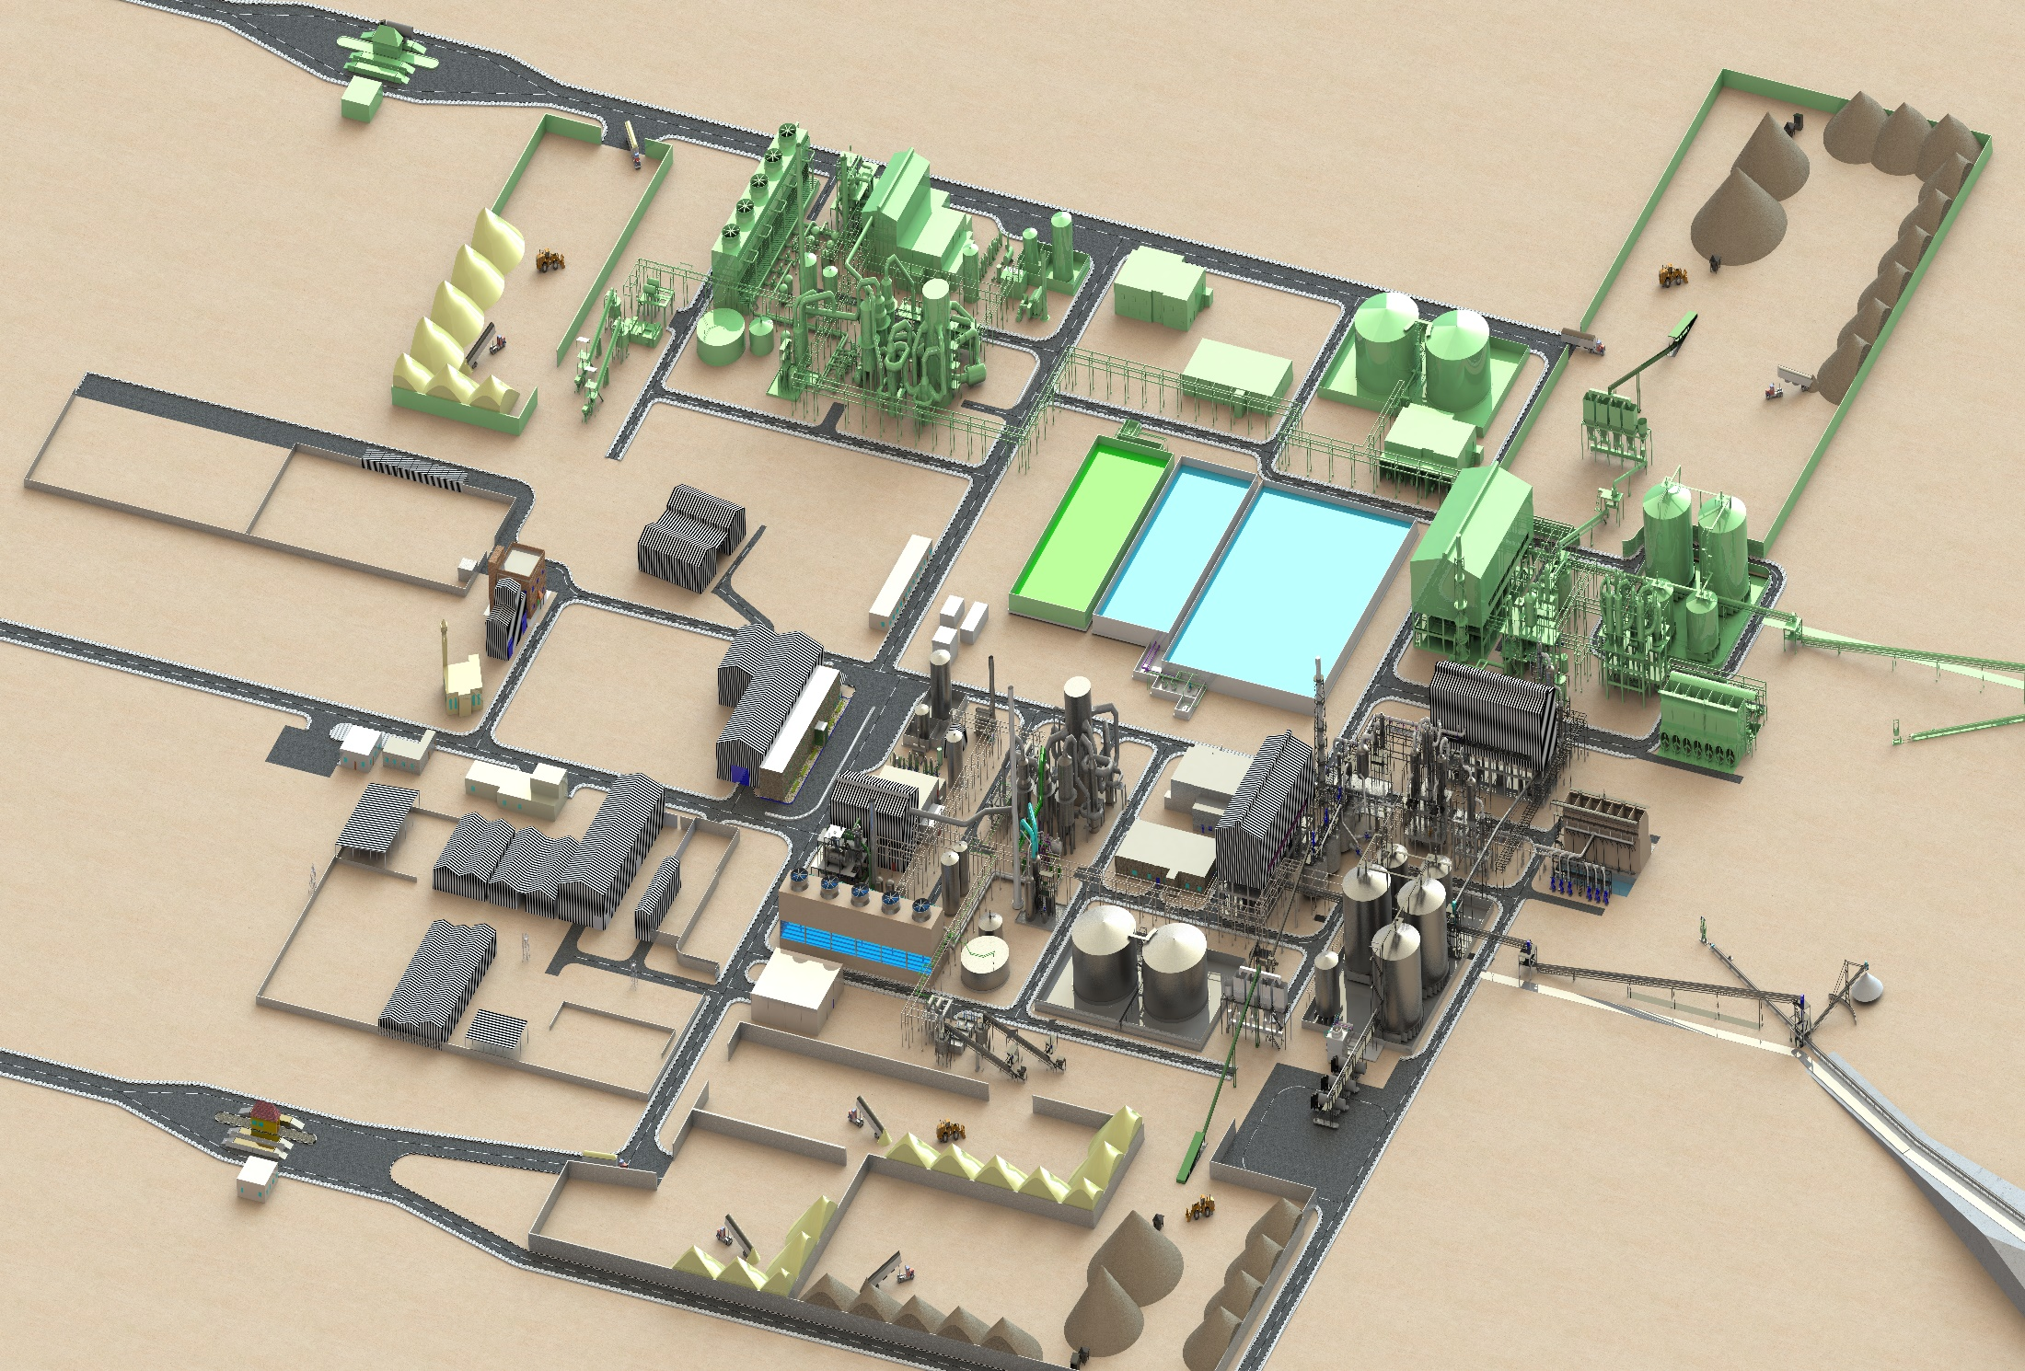
SA/PA PLANT REVAMP 3D MODEL

Slide 8
ENERGY INTEGRATION & POWER STRATEGY
SA plant generates steam and electricity for site operations.
Turbo-Generator and steam extraction minimize reliance on national grid.
Closed-loop water and steam systems improve energy efficiency.
Power generation will increase from 11 MW to 21 MW with increase in Power export from 4 MW to 11MW which makes IJC energy self reliant.

Slide 9
ENVIRONMENTAL & ZLD INITIATIVES
Zero Liquid Discharge achieved via internal recycling and treatment systems.
FSA recovery to produce AlF₃ – turning by-product into marketable product.
Dry gypsum handling reduces contamination risks and allows reuse.

Slide 10
GDP CONTRIBUTION : CURRENT VS. POST-EXPANSION
JPMC alone contributed JD 1.23B (~$1.73B) in 2023 which is around 4% of Jordan GDP.
IJC contributes indirectly through phosphoric acid exports and joint ventures.
IJC achieved $290M in 2023, $307M in 2024 and expansion to add ~$150–200M/year in direct acid export revenue.
Estimated GDP contribution from IJC alone: ~0.3–0.4% (~$135–180M/year).
Indirect multiplier effects could push total impact close to 1% of GDP.
Enhanced tax, royalty, and dividend flows to public treasury.

Slide 11
EMPLOYMENT & SOCIO ECONOMIC BENEFITS
Employment Generation:
Creation of over 200 direct jobs
More than 500 indirect employment opportunities through contractors and logistics support
Regional Skill Development:
Focused skill enhancement programs in the Ma’an region
Helps reduce urban migration by creating local opportunities
Youth Training & Technology Transfer:
Specialized training programs for youth
Exposure to latest chemical process technologies and industrial practices

Slide 12
ECONOMIC IMPACT
National Income: Downstream industry boosted JPMC’s profits (2022 net profit JD 735M – highest ever). More corporate tax & dividends to Jordan.
Foreign Exchange: Phosphate/fertilizer exports bring critical FX (over $2.5B in 2021 for mining sector), supporting currency & trade balance.
Jobs: Thousands of direct jobs in mines & plants (JPMC ~4,000 staff). High-skill jobs in chemistry, engineering, operations – mostly Jordanian workforce.
Development: Downstream projects spur infrastructure (ports, rail) and ancillary services, contributing to regional development (especially Aqaba & south Jordan).

Slide 13
AQABA PORT & INFRASTRUCTURE GAINS
Higher export volume increases throughput at Aqaba Industrial Port.
Revenue growth for port JV (JPMC + Arab Potash Co.).
Boosts trucking, storage, and handling services.
Challenges: energy and water costs – addressed via renewables and ZLD.

Slide 14
GLOBAL BENCHMARKING AND CHALLENGES
Competing with Morocco, China, Russia in acid exports.
Jordan: Low-cadmium rock, high reliability supplier
Jordan’s edge: Political neutrality, stable operations.
Challenges: energy and water costs – addressed via renewables and ZLD.

Slide 15
ALIGNMENT WITH JORDAN’S EMV
National Economic Objectives:
Aligns with job creation, foreign direct investment (FDI) attraction, and export expansion goals
Industrial Decentralization & Infrastructure Development:
Bridges regional infrastructure gaps
Encourages industrial decentralization and balanced regional growth
Strategic Alignment:
Recognized as a model project under the national economic transformation roadmap

Slide 16
SUMMARY OF STRATEGIC GAINS
Industrial Output & Export Growth:
Significant increase in national acid production
Boosts phosphoric acid exports and enhances Jordan's global market share
Energy & Raw Material Self-Sufficiency:
Achieves self-reliance in sulfuric acid supply
Ensures secure and stable energy inputs for production processes
Environmental & Economic Impact:
Promotes environmental leadership through modern technologies
Supports economic decentralization by strengthening regional industry

Slide 17
CONCLUSION & WAY FORWARD
IJC expansion reinforces Jordan’s phosphate leadership.
Demonstrates how strategic upgrades can multiply national benefits.
Blueprint for sustainable industrial growth in Jordan and beyond.

Slide 18
Thank You!!

